Slide 1

BSSE -Software Quality Engineering Week-3 Lecture 5-6 Semester 6- Fall 2020

Slide 2



Slide 3





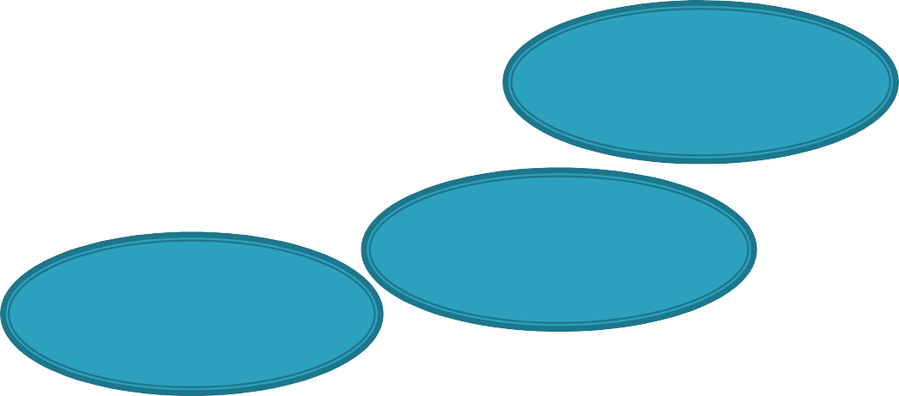
The quality assurance techniques and activities
(Alternatives) which we will be compare :
Testing
Inspection
QA
Techniques
Defect prevention
formal verification
fault tolerance
failure
containment

Slide 4
Comparison of the different quality assurance (QA) techniques and activities will achieve by examining many questions and criteria related to :
their effectiveness in dealing with different types of problems.
their cost.
their applicability under different environments and development phases.

Slide 5
comparing different QA alternatives by examining the:
specific perspectives of defect they are dealing with,
kind of problems they are good at addressing,
their suitability to different defect levels and
pervasiveness,
their ability to provide additional information for quality improvement.

Slide 6
Defect perspective:
Examine is the QA technique dealing with errors, faults, or failures?
This examination can be broken down into two parts :
Detection or observation of specific problems from specific defect perspectives.
Types of follow-up actions that deal with the observed or detected problems.

Slide 7
The table show the Defect observed and dealt with by different QA alternatives
QA Alternative Defect Perspective
At Observation failures
At Follow-up(& Action) fault removal
testing
defect prevention inspection
formal verification fault tolerance failure containment
reduced fault injection fault removal
fault absence verified global failures avoided hazards resolution &
damage reduction
errors & error sources faults
(absence of) faults local failures accidents

Slide 8
Problem types:
Different QA alternative might be effective for different types of problems, including dealing with different perspectives of defects.
the table show the main problem types dealt with by different QA alternatives
QA Alternative defect prevention
Problem Types
systematic errors or conceptual
mistakes (by programmer, designer)
dynamic failures & related faults static & localized faults
logical faults, indirectly operational failures in small areas accidents and related hazards
testing inspection
formal verification fault tolerance failure containment

Slide 9
 Difference in detected defects can be explained by the following differences between the two types of QA alternatives:
inspection vs testing :
Inspection identifies faults directly by examining the software artifact, while testing observing failure but identifies faults indirectly later by utilizing the recorded execution information.
It is hard for human inspectors to keep track of complicated interactions over time not like computer, therefore testing is generally better at detecting interaction problems
Human inspectors can focus on a small area and perform in- depth analysis, so leading to effective detection of localized faults.

Slide 10
Defect level and pervasiveness:
Defect levels where different QA alternatives are suitable:
QA Alternative Defect Level
testing
defect prevention
low - medium
low - high (particularly pervasive
problems)
medium - high low
low
Lowest
inspection
formal verification fault tolerance failure containment

Slide 11
Result interpretation and constructive information:
Ease of result interpretation for different QA alternatives and amount of constructive information/measurements
QA Alternative Result Interpretation
Information/Measurement
testing
defect prevention
inspection
formal verification fault tolerance
moderate (intangible) easy
hard hard
executions & failures experience
faults, already located
fault absence verified
(unanticipated) environments/usages
accident scenarios and hazards
failure containment
hard

Slide 12
We can first divide our examination of the applicability environments into two:
Development environment
maintenance environment

Slide 13
the applicability to software maintenance may vary, as follows:
Defect prevention techniques are typically not
applicable to the software maintenance
process
Inspection, formal verification, and testing can be applied to a very limited degree to software maintenance process
Defect containment alternatives, such as fault tolerance and failure containment, apply to software in operation and also can be applied to the software maintenance process.

Slide 14

the development process
related activities and phases
the general project environment.

Slide 15

Objects of QA alternatives
QA Alternative
Object
Testing
defect prevention
(executable) code (implementation activities)
inspection
formal verification
design, code, and other software
artifacts
design/code with formal specification
operational software system
fault tolerance failure containment
system with potential accidents

Slide 16
Development activities where different QA alternatives are applicable
QA Alternative
Development Activity/Phase
testing
defect prevention
testing phase and after implementation
(req/spec/design/coding)
all
design/coding
in-field operation in-field operation
inspection
formal verification fault tolerance failure containment

Slide 17
Required participant expertise
Required expertise and background knowledge for people to perform different QA alternatives
QA Alternative Expertise Level Background Knowledge
testing
defect prevention inspection
formal verification fault tolerance failure containment
low - high medium – high low - medium
high high high
formal training dynamic systems safety, embedded
systems

Slide 18

The direct cost for carrying out the planned QA activities typically involves:
the time and effort of the software professionals who perform related activities and the consumption of other resources such as computer systems and supporting facilities.

Slide 19
there are also indirect costs, such as:
training project participants
acquisition and support for related software tools
meeting time and other overhead.

Slide 20
Simplicity of the techniques associated with the specific QA alternatives
Availability of tool support also has a significant influence on the cost of specific QA alternatives.
There are several factors affecting the above total cost

Slide 21

effort of detecting problems
effort of fixing the problems
the defect prevention techniques
fault tolerance
failure containment

Slide 22
For the cases of fault tolerance and failure containment, the cost includes three parts:
Operational cost of having specific mechanisms in the operational systems.
Implementation cost to design, implement, and assure selected features and mechanisms.
Failure or accident cost

Slide 23
Cost:
Cost comparison for different QA alternatives
QA Alternative
cost
testing
defect prevention
inspection
formal verification
fault tolerance failure containment
medium (low - high)
Low
low - medium
high
high highest

Slide 24
Quality Engineering
• From QA to SQE – QA activities need additional support:
• Planning and goal setting for quality
• Measurement
• Feedback
• QA + above =Software Quality Engineering (SQE)
• SQE activities in chronological order: – Pre-QA activities – In-QA activities – Post-QA activities

Slide 25
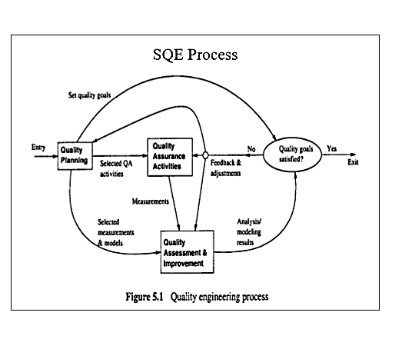

Slide 26
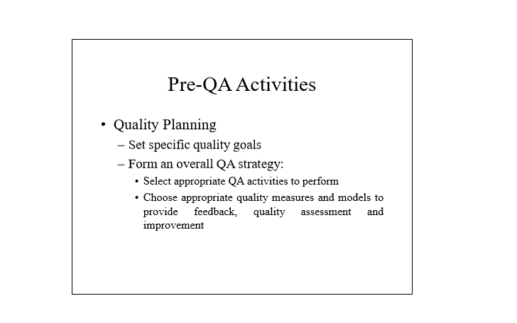

Slide 27
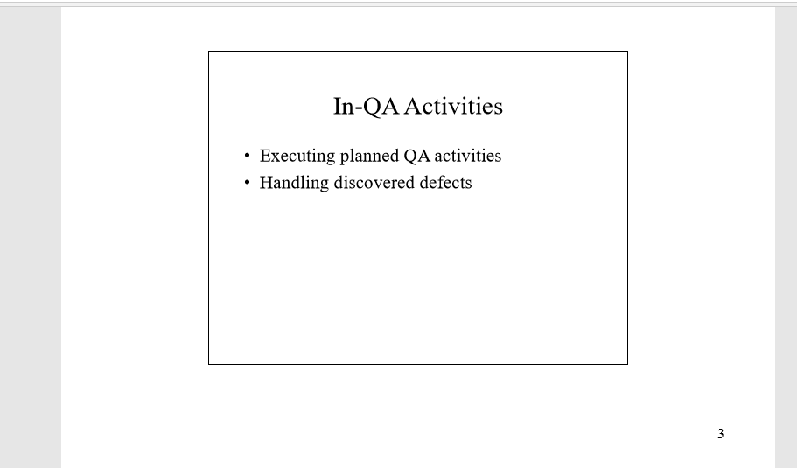

Slide 28
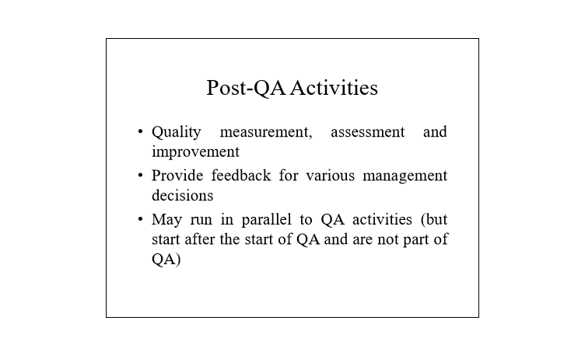

Slide 29
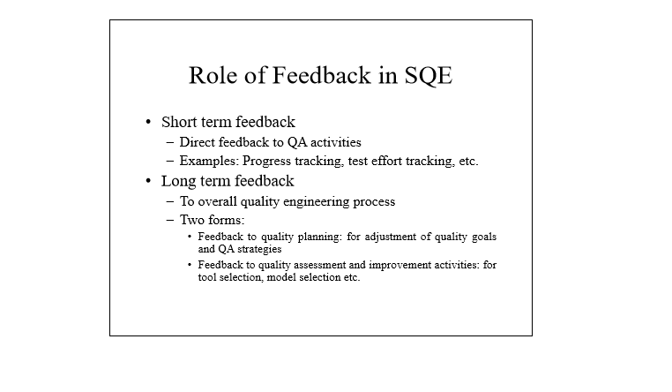

Slide 30
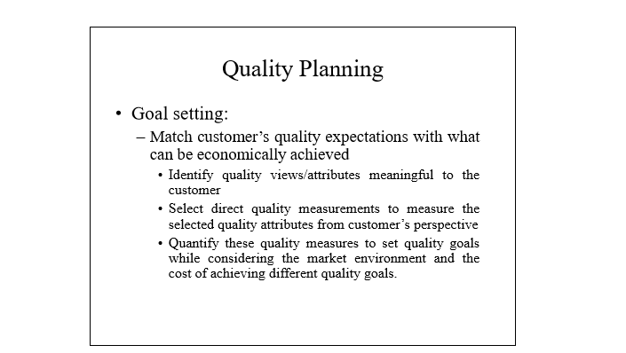

Slide 31
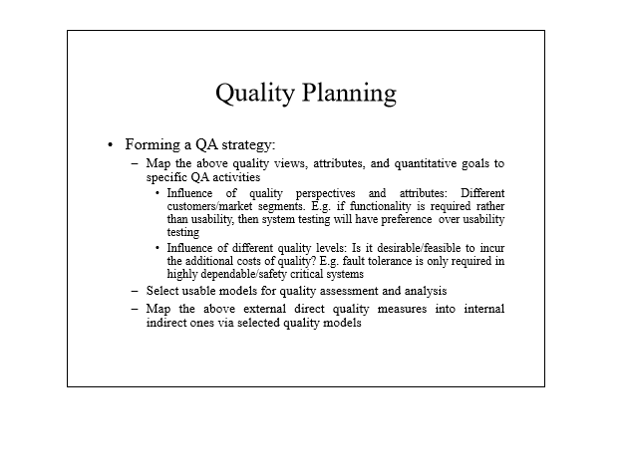

Slide 32
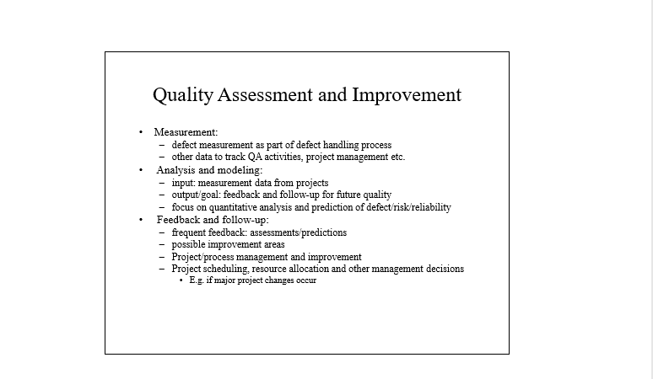

Slide 33
